Slide 1
Designing and Engineering Secure Mechanisms
This lecture slide is mainly based on the power point slides by Professor Lawrie Brown, Dr. Junjie Zhang.

Slide 2
Outlines
Design
Principles
Models
Engineering
Secure Software Development Process

Slide 3

Design Principles
“The Protection of Information in Computer Systems”, Saltzer and Schroeder, Section I,A.
Published in 1975
Do these principles still apply today?

Slide 4
Principle of Economy of Mechanism
Security mechanisms should be as simple as possible.
Fewer errors; less checking and testing
KISS: “Keep it Simple, Stupid”
Notes:
If a design and implementation are simple, fewer possibilities exist for errors. The checking and testing process is less complex, because fewer components and cases need to be tested. Complex mechanisms often make assumptions about the system and environment in which they run. If these assumptions are incorrect, security problems may result.
Interfaces to other modules are particularly suspect, because modules often make implicit assumptions about input or output parameters or the current system state; should any of these assumptions be wrong, the module's actions may produce unexpected, and erroneous, results. Interaction with external entities, such as other programs, systems, or humans, amplified this problem.
The KISS mantra is pervasive: "Keep It Simple, Stupid!" This motto applies just as well to security as it does everywhere else. Complexity increases the risk of problems. Avoid complexity and avoid problems.
The most obvious implication is that software design and implementation should be as straightforward as possible. Complex design is never easy to understand, and is therefore more likely to include subtle problems that will be missed during analysis. Complex code tends to be harder to maintain as well. And most importantly, complex software tends to be far more buggy. We don't think this comes as any big surprise to anyone.

Slide 5
Principle of Economy of Mechanism
(a) Industry Average: "about 15 - 50 errors per 1000 lines of delivered code." He further says this is usually representative of code that has some level of structured programming behind it, but probably includes a mix of coding techniques.
(b) Microsoft Applications: "about 10 - 20 defects per 1000 lines of code during in-house testing, and 0.5 defect per KLOC (KLOC IS CALLED AS 1000 lines of code) in released product (Moore 1992)." He attributes this to a combination of code-reading techniques and independent testing.
--“ratio of bugs per line of code” (src: “http://www.mayerdan.com/ruby/2012/11/11/bugs-per-line-of-code-ratio/”)

Slide 6
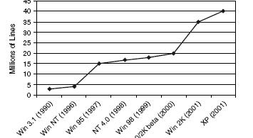
Principle of Economy of Mechanism

Slide 7
Principle of Fail-Safe Defaults
If a system fails, it should reach at safe states by default.
Example: unless a subject is given explicit access to an object, it should be denied access to that object.

Slide 8
Principle of Fail-Safe Defaults
Pay Attention to Failure Modes
Do not forget the code that handles errors.
bool accessGranted = true; // optimistic!
try {
// see if we have access to c:\test.txt
new FileStream(@"c:\test.txt”, FileMode.Open, FileAccess.Read).Close();
}
catch (SecurityException x) {
// access denied
accessGranted = false;
}
catch (...) {
// something else happened
}

Slide 9
Principle of Fail-Safe Defaults
Fail Intelligently
Be sure that if your code fails, it leaves the system in the most secure state possible.
bool accessGranted = false; // pessimistic!
try {
// see if we have access to c:\test.txt
new FileStream(@"c:\test.txt”, FileMode.Open, FileAccess.Read).Close();
// if we're still here, we're good!
accessGranted = true;
}
catch (...) {}

Slide 10
Principle of Fail-Safe Defaults
Fail Intelligently
Be sure that if your code fails, it leaves the system in the most secure state possible.
DWORD dwRet = IsAccessAllowed(…);
if (dwRet == ERROR_ACCESS_DENIED) {
// Security check failed.
// Inform user that access is denied
} else {
// Security check OK.
// Perform task…
}
What if
IsAccessAllowed()
returns
ERROR_NOT_ ENOUGH_MEMORY?

Slide 11
Principle of Fail-Safe Defaults
Fail Intelligently
Do not:
Reveal information in error messages
Accidently reveal your debug information to users?
E.g., passing SQL exceptions to a WebUser without filtering.
Consume resources for lengthy periods of time after a failure
Do:
Use exception handling blocks to avoid propagating errors back to the caller
Write suspicious failures to an event log

Slide 12
Principle of Complete Mediation
All accesses to objects be checked to ensure that they are allowed.
When you log into an email system, if you want to modify your email password, the email system will check if you can modify the password by authenticating you again.
Notes:
Every time, a user accesses a field or a record of a file, or a data item in a database, the system must exercise access control.

Slide 13
Principle of Complete Mediation
All User Inputs are evil!
Do not trust user input
Malicious input can lead to buffer overruns, cross-site scripting attacks, SQL injection attacks, and more
Assume all input is harmful until proven otherwise
Look for valid data and reject everything else
Constrain, reject, and sanitize user input with
Type checks
Length checks
Range checks
Format checks

Slide 14
Principle of Complete Mediation
Use system call sequence to profile the behavior of a process
………
F=open(“./t.txt”);
for(i=0; i<1; i++)
{
buf=read(F);
Z=mmap(buf);
foo(buf)
}
clsoe(F);
……
void foo (char *bar)
{
char c[12];
strcpy (c, bar);
}
Process
System Call Sequence
open, read, mmap, read, mmap, close
Intercept
System
Reference monitor
System Calls
Notes:
mmap, munmap - map or unmap files or devices into memory

Slide 15
Principle of Complete Mediation
Process
Untrusted code
System Call Sequence
open, read, mmap, read, mmap, close
Intercept
System
System Calls
Notes:
mmap, munmap - map or unmap files or devices into memory
Untrusted code access data or variable inside the process, does not need to go through the reference monitor to do complete mediation.
You might can put the untrusted code into a different process, to force it to go through the mediation process to access the data in the current process.

Slide 16
Principle of Complete Mediation
Software-Based Fault Isolation
Logical fault domain for untrusted code “0300” to “03FF”
The original instruction “write x” will be translated to
cmp x 0300
if less Error
cmp x 03FF
if greater Error
write x
-http://www.cs.cornell.edu/courses/cs513/2000sp/L13.html
Notes:
http://www.cs.cornell.edu/courses/cs513/2000sp/L13.html

Slide 17
Principle of Complete Mediation
Access control models of Linux/Windows/Mac
A user (identified by UID) will start multiple processes/apps
App1 creates a file and app2 reads the file. Is it allowed?
Android
Each process has its own UID
Notes:
http://www.cs.cornell.edu/courses/cs513/2000sp/L13.html

Slide 18
Principle of Complete Mediation
DMZ
Intranet
Internet
DNS
Mail
Web
Intra2(win2003)
Server
Server
Server
Firewall
Firewall
SW
Outer Firewall
Inner Firewall
SW
SW
Intra1 (XP)
From C. Edward Chow at UCCS
Notes:
If the intra1 (laptop) is brought out of the lab, and got infected. When it is brought back to the lab, it tries to access the data stored on other computers in the lab, and leak it. Since this laptop does not need to go through the inner Firewall to access other computers inside the intranet, so it did not go through the complete mediation process.
You can configure the switch inside the intranet to do the mediation.

Slide 19

Principle of Complete Mediation
DMZ
Intranet
Internet
DNS
Mail
Web
Intra2(win2003)
Server
Server
Server
Firewall
Firewall
SW
SW
SW
IPS Outer
IPS
Inner
IDS
Honeypot
IDS
Intra1 (XP)
From C. Edward Chow at UCCS

Slide 20
Principle of Separation of Privilege
A system should not grant permission based on a single condition.
Separation of duty principle.
A email client: receiving email + sending email
Separate the privilege:
The receiver cannot touch files other than attachments.
The sender can touch all files.
Advantage:
When the receiver is compromised, files are still secure.

Slide 21
Principle of Least Privilege
A subject should be given only those privileges that it needs in order to complete its task.
Two practical challenges:
How do you define necessity?
Granularity of information to enforce privilege check?
Notes:
Granularity of information: bit, or byte, or page, or a file?
If the granularity of information is in the bit level, it is too expensive.

Slide 22
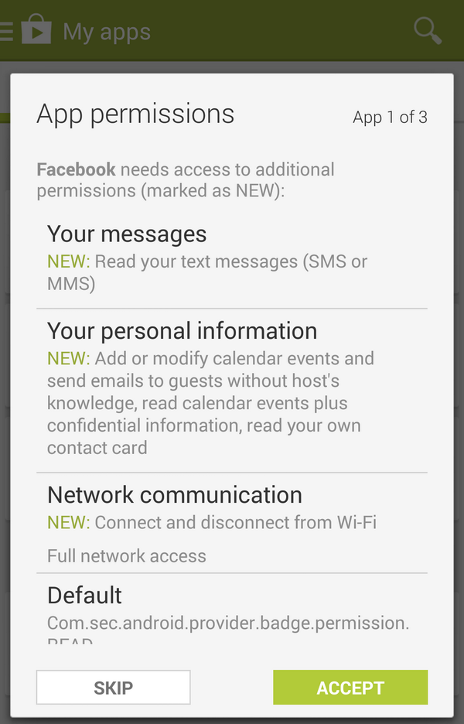
Principle of Least Privilege

Slide 23
Principle of Least Privilege
Grant permissions at installation?
But perhaps I will never use my app to access the contact list.
Grant permissions at the first time of usage.
What about the subsequent usage?

Slide 24
Principle of Least Privilege
Give an application the access to the contact list?
Give an application the access to specific persons on the contact list?
Give an application the access to specific information of a person on the contact list?

Slide 25
Principle of Least Common Mechanism
Mechanisms used to access resources should not be shared.
Do you want to use the same password for your different online accounts?
Notes:
The weaknesses found on a Windows system, can be used by the attacker to attack all the other systems with the same windows OS systems.
Introduce diversity, i.e., use different OS systems.
If different computer systems use different OS systems, then the attacker’s job would be much harder, since it cannot reuse the same attacks against different systems with different OS systems. The maintenance of the computing systems will be more expensive.
Security/performance trade off.

Slide 26
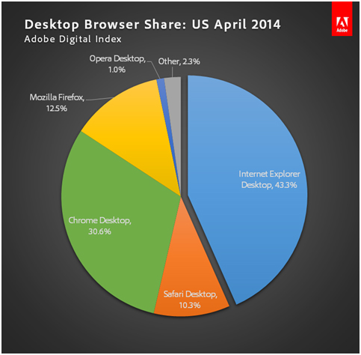
Principle of Least Common Mechanism
Notes:
Most users are still using the same browser, i.e., the same software. – violation of the least common mechanism.

Slide 27
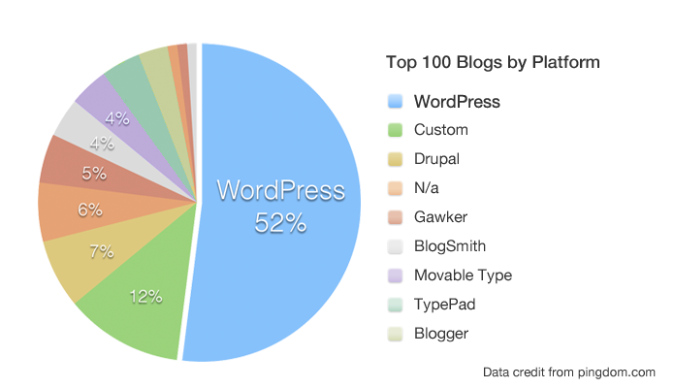
Principle of Least Common Mechanism
Notes:
Wordpress: content publishing platform, and it welcomes plugins, and the plugins are not verified.
If a plugin of wordpress has weaknesses, then all the users who are using wordpress will have the same weaknesses. Since roughly 52% of the users use wordpress, so it would be a problem. –violation of the least common mechanism.
Again, introduce more diversity.

Slide 28
Principle of Least Common Mechanism
https://blog.sucuri.net/category/wordpress-security
Notes:
How to introduce more diversity:
You want the process of introducing diversity to be systematic, and automatic.
Editing Source code → Compiling → Linking (Library functions) → Loading and Running
Source code with different languages.
Compiling phase: Adding boundary checks, with different boundary check values if it is too hard to change the programming language.
Calling library functions from different vendors – some library functions might have weaknesses.
OS systems can encrypt the programs, with different keys.

Slide 29
Principle of Least Common Mechanism
Positive Examples
Address space layout randomization
Instruction set randomization
DNS 0x20 Encoding
Similar to moving target defense
Moving target defense: Aim to substantially increase the cost of attacks by deploying and operating networks/systems to makes them less deterministic, less homogeneous, and less static.
Continually shift and change over time to increase complexity and cost for attackers, limit the exposure of vulnerabilities and opportunities for attack, and increase system resiliency.
Dynamically altered in ways that are manageable by the defender yet make the attack space appear unpredictable to the attacker.
Notes:
Aim to substantially increase the cost of attacks by deploying and operating networks/systems to makes them less deterministic, less homogeneous, and less static.
•Continually shift and change over time to increase complexity and cost for attackers, limit the exposure of vulnerabilities and opportunities for attack, and increase system resiliency.
•Dynamically altered in ways that are manageable by the defender yet make the attack space appear unpredictable to the attacker.
•Also known as “Cyber Maneuver”, “Adaptive Cyber Defense”
Reactive → Proactive
Static → Dynamic
•Enables defenders to create, analyze, evaluate, and deploy mechanisms and strategies that continually shift and change over time to increase complexity and cost for attackers
limit the exposure of vulnerabilities and opportunities for attack, increase system resiliency and establish foundation for “fighting thru the attack”

Slide 30
Principle of Open Design
The security of a mechanism should not depend on the secrecy of its design or implementation.
d = system.timestamp();
Key = hash(d);
Notes:
Kerckhoffs principle

Slide 31
Principle of Psychological Acceptability
Security mechanisms should not make the resource more difficult to access than if the security mechanisms were not present.
Our passwords for W---- accounts are required to be changed every 3 months
How much do you actually change for your password?

Slide 32
Other Principles
Principle of Work Factor
Do you have reasonable assumption of attackers?
Principle of Compromising Recording
sometimes it is more desirable to record the details of intrusion that to adopt a more sophisticated measure to prevent it.
Notes:
The log files should not be compromised.

Slide 33
Other Principles
Isolation
Public access should be isolated from critical resources (no connection between public and critical information)
Users files should be isolated from one another (except when desired)
Security mechanism should be isolated (i.e., preventing access to those mechanisms)
Encapsulation: similar to object concepts (hide internal structures)
Modularity: modular structure
Notes:
Modularity: Cryptographic functions as common cryptographic modules, can be invoked by many security protocols and applications.

Slide 34
Other Principles
Layering (defense in depth): use of multiple, overlapping protection approaches
By placing safeguards at two or more points along the access path to the asset, failure of one safeguard can be counteracted.
Least astonishment: a program or interface should always respond in a way that is least likely to astonish a user
Notes:
Layering (defense in depth): the failure of any individual protection approach will not leave the system unprotected.
Layering (defense in depth): requires an understanding to the specific threats

Slide 35
Security Models

Slide 36
Disclaimer
These lecture notes are mainly based on the power point slides by the author of the book “Information Security: Principles and Practice”, Dr. Mark Stamp.

Slide 37
Classifications and Clearances
Classifications apply to objects
Clearances apply to subjects
US Department of Defense uses 4 levels of classifications/clearances
TOP SECRET
SECRET
CONFIDENTIAL
UNCLASSIFIED

Slide 38
Clearances and Classification
To obtain a SECRET clearance requires a routine background check
A TOP SECRET clearance requires extensive background check
Practical classification problems
Proper classification not always clear
Level of granularity to apply classifications
Aggregation --- flipside of granularity

Slide 39
Subjects and Objects
Let O be an object, S a subject
O has a classification
S has a clearance
Security level denoted L(O) and L(S)
For DoD levels, we have
TOP SECRET > SECRET > CONFIDENTIAL > UNCLASSIFIED

Slide 40
Multilevel Security (MLS)
MLS needed when subjects/objects at different levels use same system
MLS is a form of Access Control
Military/government interest in MLS for many decades
Lots of funded research into MLS
Strengths and weaknesses of MLS relatively well understood (theoretical and practical)
Many possible uses of MLS outside military

Slide 41
MLS Applications
Classified government/military information
Business example: info restricted to
Senior management only
All management
Everyone in company
General public
Network firewall
Keep intruders at low level to limit damage
Confidential medical info, databases, etc.

Slide 42
MLS Security Models
MLS models explain what needs to be done
Models do not tell you how to implement
Models are descriptive, not prescriptive
High level description, not an algorithm
There are many MLS models
We’ll discuss simplest MLS model
Other models are more realistic
Other models also more complex, more difficult to enforce, harder to verify, etc.

Slide 43
Bell-LaPadula
BLP security model designed to express essential requirements for MLS
BLP deals with confidentiality
To prevent unauthorized reading
Recall that O is an object, S a subject
Object O has a classification
Subject S has a clearance
Security level denoted L(O) and L(S)

Slide 44
Bell-LaPadula
BLP consists of
Simple Security Condition: S can read O if and only if L(O) ≤ L(S)
*-Property (Star Property): S can write O if and only if L(S) ≤ L(O)
No read up, no write down

Slide 45
Integrity Model
BLP for confidentiality, Biba for integrity
Biba is to prevent unauthorized writing
Biba is (in a sense) the dual of BLP
Integrity model
Spse you trust the integrity of O but not O
If object O includes O and O then you cannot trust the integrity of O
Integrity level of O is minimum of the integrity of any object in O

Slide 46
Biba’s Model (Strict Integrity Policy)
Let I(O) denote the integrity of object O and I(S) denote the integrity of subject S
Biba
S can write O if and only if I(O) ≤ I(S)
(if S writes O, the integrity of O ≤ that of S)
S reads O if and only if I(O) ≥ I(S)
(if S reads O, the integrity of S must be lower than that of O)
Often, replace Biba’s Model with
Low Water Mark Policy: If S reads O, then I(S) = min(I(S), I(O))

Slide 47
Low-Water-Mark Policy
Let I(O) denote the integrity of object O and I(S) denote the integrity of subject S
Low Water Mark Policy
S can write O if and only if I(O) ≤ I(S)
(if S writes O, the integrity of O ≤ that of S)
S reads O then I(S) = min(I(S), I(O))
(if S reads O, the integrity of S is the minimum integrity of S and O)
S use less trusted data (I(O) ≤ I(S)) to operate, the integrity level of S is will be decreased.

Slide 48
BLP vs Biba
BLP
Biba
high
high
l
e
v
e
l
L(O)
L(O)
I(O)
l
e
v
e
l
L(O)
I(O)
I(O)
low
Confidentiality
Integrity
low

Slide 49
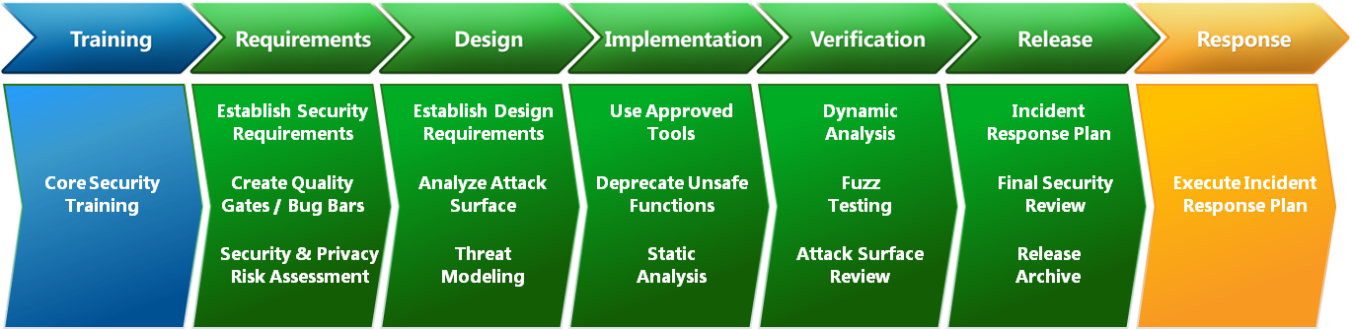
Secure Software Development Process
Figure 1. Secure software development process model at Microsoft
Source: “Microsoft Security Development Lifecycle, SDL Process Guidance Version 5.2”
More readings: Microsoft Security Development Lifecycle (SDL) Process Guidance - Version 5.2
Notes:
Software attack surface: this refers to vulnerabilities in application, utility, or operating system code. A particular focus in this category is web server software.
Find ways to make the attack surface smaller, to make the attacker’s jobs harder.
Network attack surface: vulnerabilities in the enterprise network, wide area network, or the Internet, like open ports, network protocol vulnerabilities.
Human attack surface: vulnerabilities created by personnel or outsiders, such as social engineering, human error, and trusted insiders.

